Slide 1
COMP 53 – Week One
OOPs Review

Slide 2
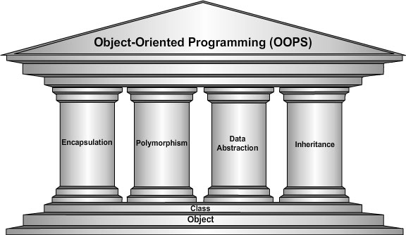
Learning Objectives – Intro to OOP

Slide 3
Why Do We Care
Foundation for this class!
Ability to think in terms of data + logic
Add more tools in you programming toolbox

Slide 4
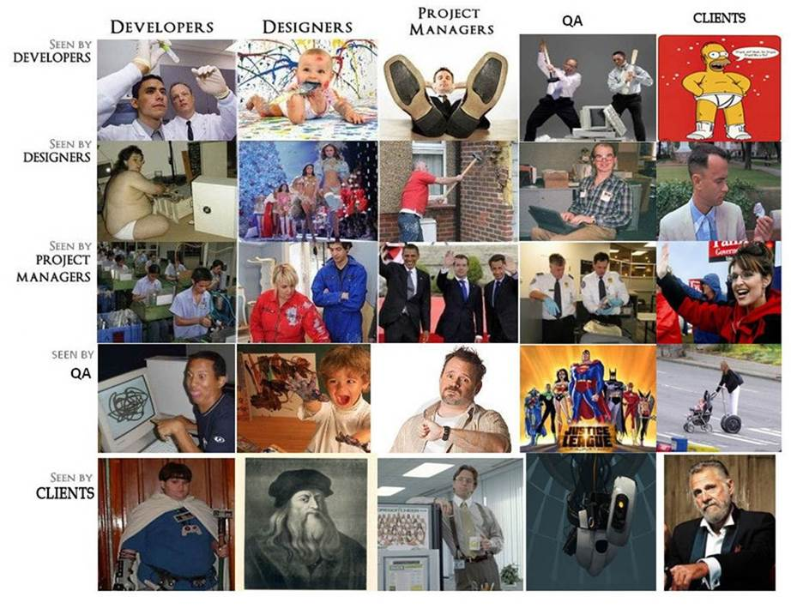

Slide 5
Procedural vs OOP
Procedural Addresses – “What does this program have to do?”
Object Oriented – “What things are in this program?”
Function 1
Method 1
Method 1
Shared Data
Class Data
Class Data
Function 2
Function 3
Method 2
Method 2

Slide 6
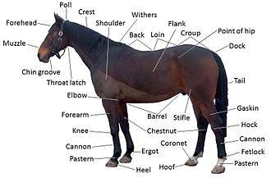

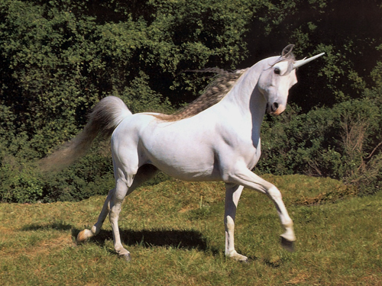
A Little Mythology
A horse has many properties or attributes
Notes:
We can extend the horse class.

Slide 7
Intro to Classes
Integral to object-oriented programming
Similar to structures
Adds member FUNCTIONS
Not just member data → merge code and data
Class Definition
class DayOfYear ← name of new class type { public: void output(); ← member function prototype! int month; int day; };
Notes:
Notice only member function’s prototype
Function’s implementation is elsewhere
Cohesion within a class
A class definition provides the public interface--messages should be closely related
The related data objects necessary to carry out a message should be in the class

Slide 8
Declaring Objects
Declared same as all variables
Predefined types, structure types
Example: DayOfYear today, birthday;
Objects include:
Data
Members month, day
Operations (member functions)
output()
Two objects declared with memory allocated

Slide 9
Object-Oriented Design Guidelines
Design Guideline
All data should be hidden within its class
Ramifications:
Good: Can't mess up the state (compiler complains)
Good: Have to create interface of member functions
Bad: Extra coding, but worth it
Design Guideline
Keep related data and behavior in one place
Ramifications
Good: Provides intuitive collection of operations
Good: Reduces the number of arguments in messages
Bad: None that I can think of

Slide 10
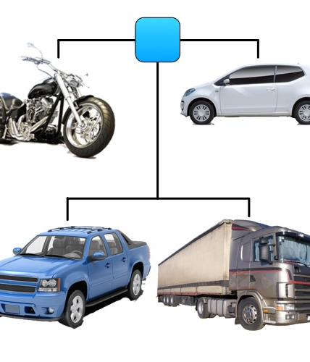
Class and Objects
A class definition is like a blueprint
An instance is an occurrence of a class
In C++, objects are instances
Class is also known as Abstract Data Type
Collection of data values together with set of basic operations defined for the values
Abstract in that the class represents some THING
Don’t need to know details of how it works
Notes:
Basic explanation - http://www.youtube.com/watch?v=IBpZBI_8QAE

Slide 11
Class Member Access
Members accessed same as structures
Example: today.month today.day
And to access member function: today.output(); ← Invokes member function

Slide 12
Class Member Functions Definition or Implementation
Can be after main() definition
Must specify class: void DayOfYear::output() {…}
:: is scope resolution operator
Instructs compiler "what class" member is from
Item before :: called type qualifier
Notes:
Like other function definitions
Notice output() member function’s definition (in next example)
Refers to member data of class
No qualifiers
Function used for all objects of the class
Will refer to "that object’s" data when invoked
Example: today.output();
Displays "today" object’s data

Slide 13
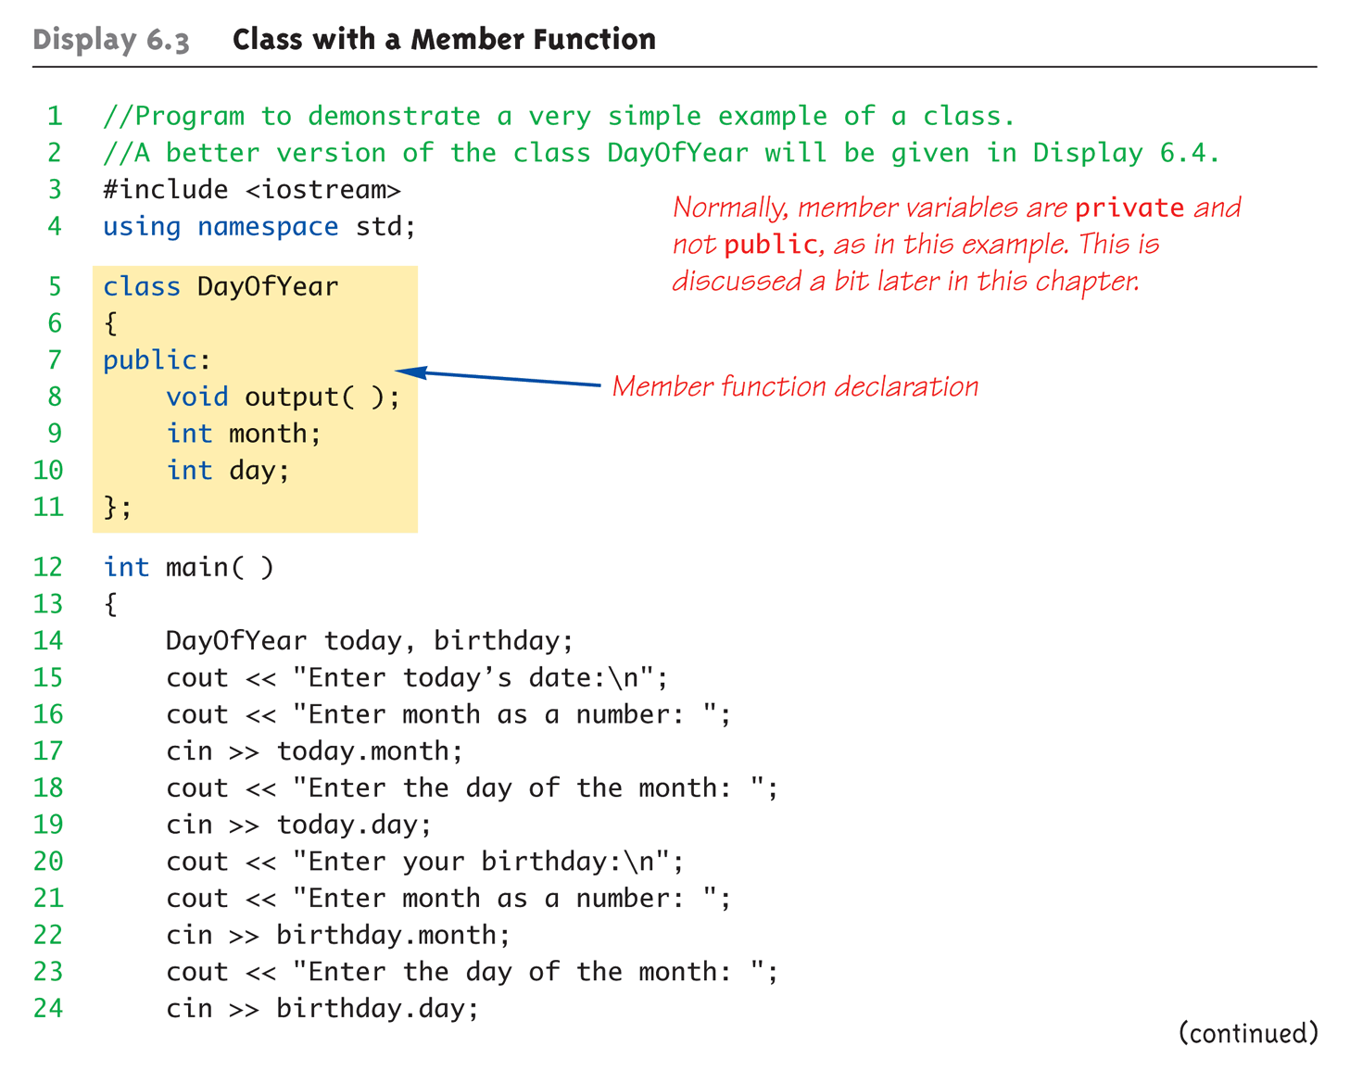
Complete Class Example: Printing out Dates (1 of 4)

Slide 14
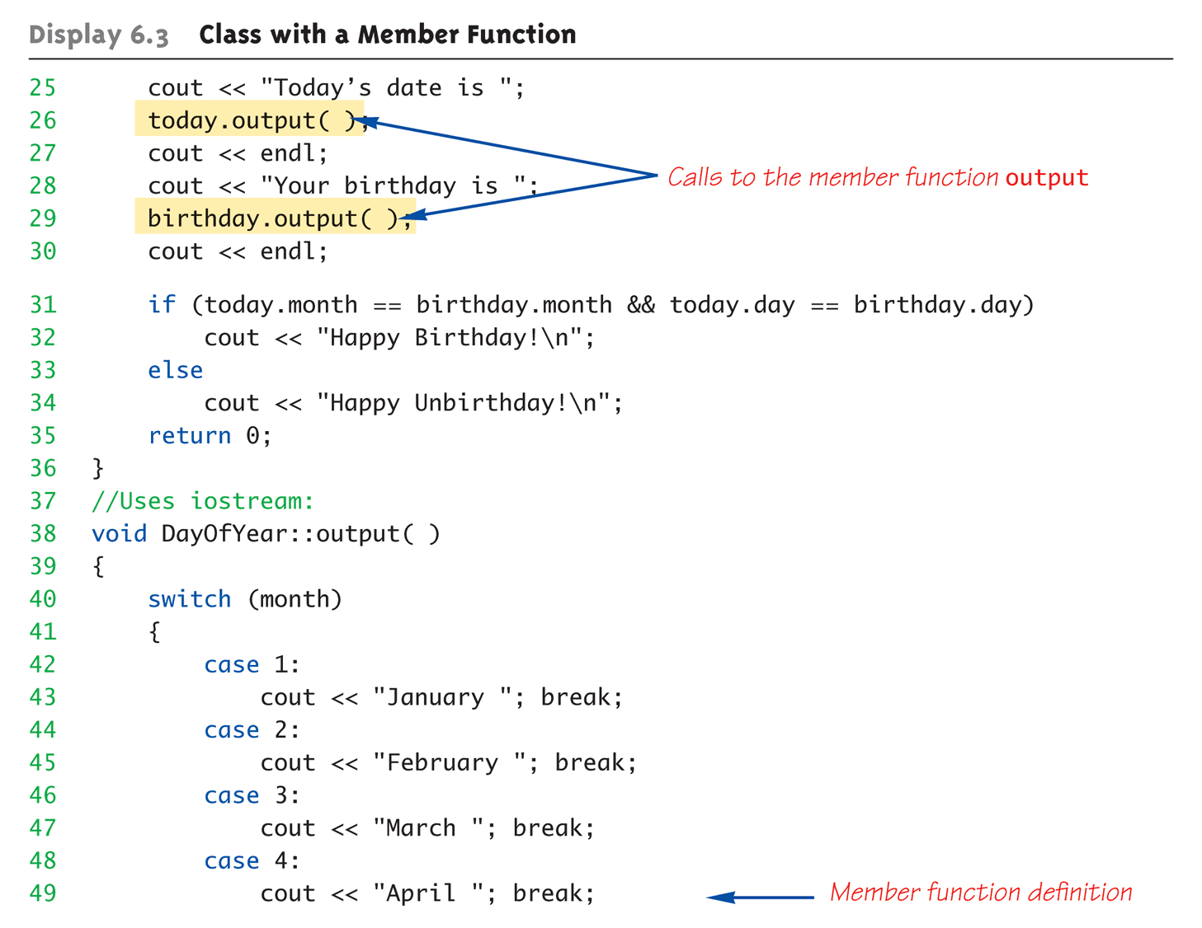
Complete Class Example: Printing out Dates (2 of 4)
Note that month variable is in scope

Slide 15
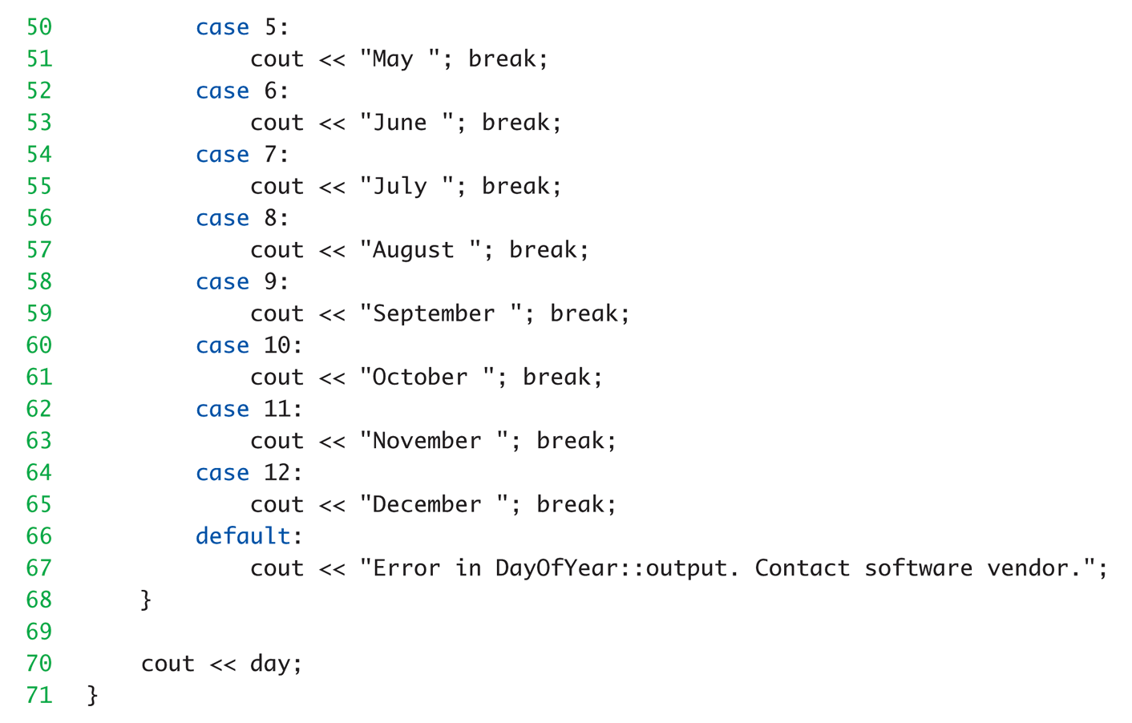
Complete Class Example: Printing out Dates (3 of 4)

Slide 16
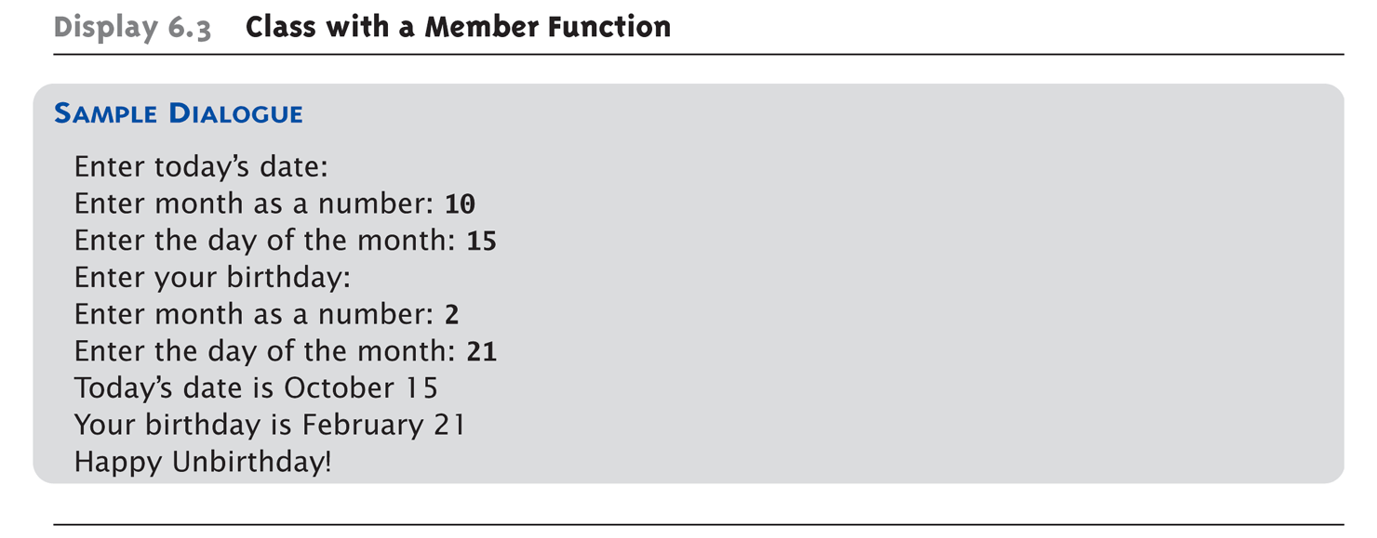
Complete Class Example: Printing out Dates (4 of 4)

Slide 17
Review - . Versus ::
Used to specify "of what thing" they are members
Dot operator specifies member of particular object
Scope resolution operator (::) specifies what class the function definition comes from

Slide 18
A Class’s Place
Class is full-fledged type!
Just like data types int, double, etc.
Can have variables of a class type
We simply call them "objects"
Can have parameters of a class type
Pass-by-value
Pass-by-reference
Can use class type like any other type!

Slide 19
Class Definition Practice
Create a new project in VisualStudio = classesPractice
Declare a vehicle class with data properties
String VIN
String make, model,
Int gasTank, doors
Double mpg
Specify class methods
setCar() – Initialize the member variables make, model, doors and gasTank (size)
printCar() – cout the make, model and VIN of car
In the main() function
Define two car variables and initialize them
Invoke the printCar function to display car info

Slide 20
Learning Objectives – Intro to OOP
Notes:
Information Hiding
Details of how operations work not known to "user" of class
Data Abstraction
Details of how data is manipulated within ADT/class not known to user
Encapsulation
Bring together data and operations, but keep "details" hidden

Slide 21
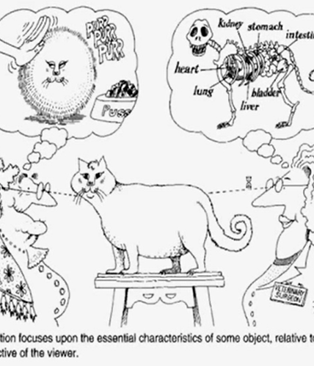
Encapsulation
Means "bringing together as one"
Object is "encapsulation" of
Data values
Example: int data type has: Data: -2147483648 to 2147483647 (for 32 bit int) Operations: +,-,*,/,%,logical,etc.
Operations on the data (member functions)
In practice
Use “getters” and “setters” for each member variable
Notes:
With Classes WE specify data, and the operations to be allowed on our data!

Slide 22
Private Parts vs Public Parts
Data in class almost always designated private in definition!
Upholds principles of OOP
Hide data from user
Allow manipulation only via operations
Which are member functions
Public items (usually member functions) are "user-accessible“

Slide 23
Public and Private Example
Modify previous example: class DayOfYear { public: void input(); void output(); private: int month; int day; };
Data now private ➔ Objects have no direct access
Dob.month = 12; // NOT ALLOWED.
cin >> dob.month; // NOT ALLOWED!
Dob.input(); // OK
Convention is that public methods and members are listed first
Hidden data defined later, since others don’t need this

Slide 24
Accessor and Mutator Functions
Object needs to "do something" with its data
Call accessor member functions – AKA “getter”
Allow object to read private data
Simple and controlled retrieval of member data
Mutator member functions – AKA “setter”
Allow object to change private data
Manipulated based on application
Called the “interface” for the class
Notes:
Interface = In C++ → public member functions and associated comments
Implementation of class hidden
Member function definitions elsewhere
User need not see them

Slide 25

What’s In Your Wallet? Encapsulation Example

Slide 26
Naming Conventions
Rules #1, 2, and 3:
1: Always use meaningful names
2: Always use meaningful names
3: Always use meaningful names
Rule #4
Constructors: Name of the class
Mutators: Verbs borrowBook withdraw
Accessors: Nouns length row nRows
could use getLength, getRow, getnRows
could use setBorrow, setWithdraw
Notes:
49
49

Slide 27
Encapsulation Practice
Using previous vehicle example
Make the data elements private
Make the methods public :
Add new method setMPG(). The input should be miles driven. This should be > 0. Then calculate the miles per gallon and assign to private variable.
Modify printCar to also show MPG

Slide 28

Constructors
Initialize objects
Set some or all member variables
Other actions possible as well
A special kind of member function
Looks like any other function, but…
Must have same name as the class
No return value
Automatically called when object declared

Slide 29
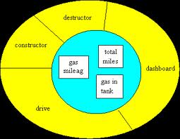
Constructor Definition Example
Class definition with constructor:
class DayOfYear { public: DayOfYear(int monthValue, int dayValue); //Constructor initializes month and day void input(); void output(); … private: int month; int day; }
Must be in public section
Notes:
Notice name of constructor: DayOfYear
Same name as class itself!
Constructor declaration has no return-type
Not even void!
Constructor in public section
It’s called when objects are declared
If private, could never declare objects!

Slide 30
Calling Constructors
Two separate variables
Declare objects: DayOfYear date1(7, 4), date2(5, 5);
Member variables month, day initialized: date1.month → 7 date2.month → 5 date1.dat → 4 date2.day → 5
Data type → definition

Slide 31
Looks like a function, BUT
Consider:
DayOfYear date1, date2 date1.DayOfYear(7, 4); // ILLEGAL! date2.DayOfYear(5, 5); // ILLEGAL!
Seemingly OK…
CANNOT call constructors like other member functions!

Slide 32
Constructor Code
Constructor definition is like all other member functions: DayOfYear::DayOfYear(int monthValue, int dayValue) { month = monthValue; day = dayValue; }
Can access the private data properties
Note – No return type

Slide 33
Shorthand Definition
Previous definition equivalent to: DayOfYear::DayOfYear( int monthValue, int dayValue) : month(monthValue), day(dayValue) ← {…}
Third line called "Initialization Section"
Body left empty
Preferable definition version

Slide 34
Constructors Should Validate
Not just initialize data
Ensure only appropriate data is assigned to class private member variables
Example
DayOfYear::DayOfYear(int monthValue, int dayValue) {
if ((month < 1) || (month > 12)) {
cout << “Illegal month value”;
exit(1);
} month = monthValue; day = dayValue; }

Slide 35
Constructor Practice
Open up the classes practice project
Convert the previous car set function to a constructor
Make sure to remove any return statement
Change the car variable definitions to use the new constructor

Slide 36
Learning Objectives – Intro to OOP
Notes:
Or overloading

Slide 37

Overloading - Defined
This motorcycle can carry
1 Box – No Problem…
2 Boxes – OK
12 Boxes. Problem!!!
Box Contains
Potato Chips. No Problem…
Exercise Weights. Problem!!!

Slide 38
Function Overloading Array Sum Example
Integer Version
int sumarray(int a[], int size) {
int sum = 0;
for (int i = 0; i < size; i++)
sum += a[i];
return(sum); }
Double Version
double sumarray(double a[], int size) {
double sum = 0;
for (int i = 0; i < size; i++)
sum += a[i];
return(sum); }
Main Call
Double total, scores[3] = {1.0, 2.5, 3.5};
Int amount, values[3] = {5, 10 , 15};
Total = sumarray(scores, 3);
Amount = sumarray(values, 3);
Can also change number of parameters
Same function name, but different data types

Slide 39
Overloaded Constructors
Can overload constructors just like other functions
Recall: a signature consists of:
Name of function
Parameter list
Provide constructors for all possible argument-lists
Particularly "how many"

Slide 40
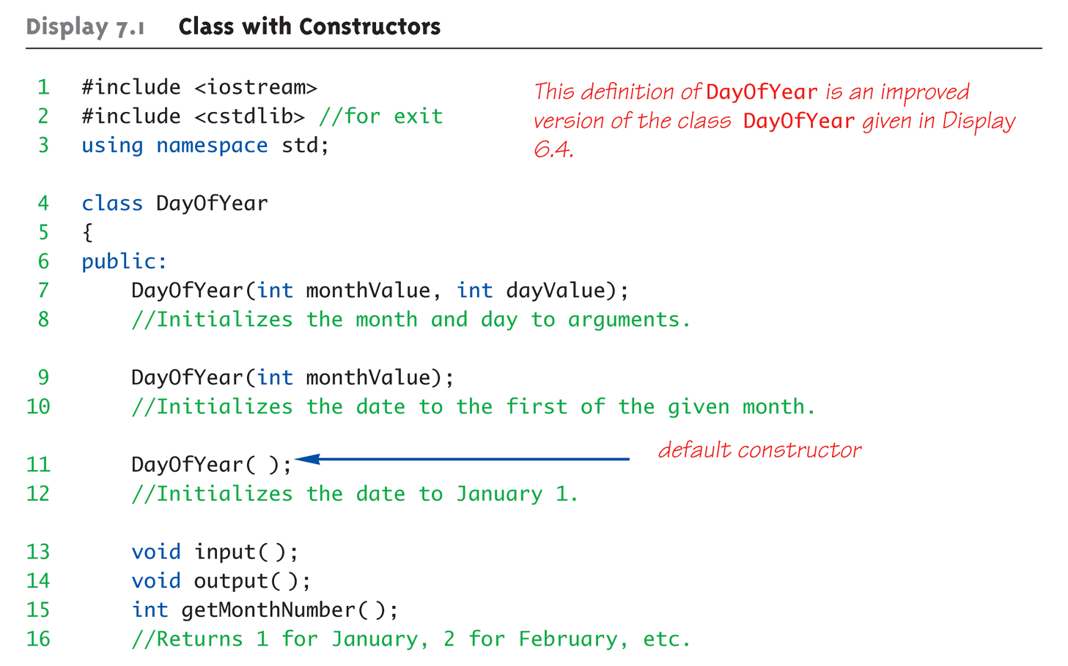
Class Constructors Overload Example (1 of 3)
Note the different versions of constructor

Slide 41
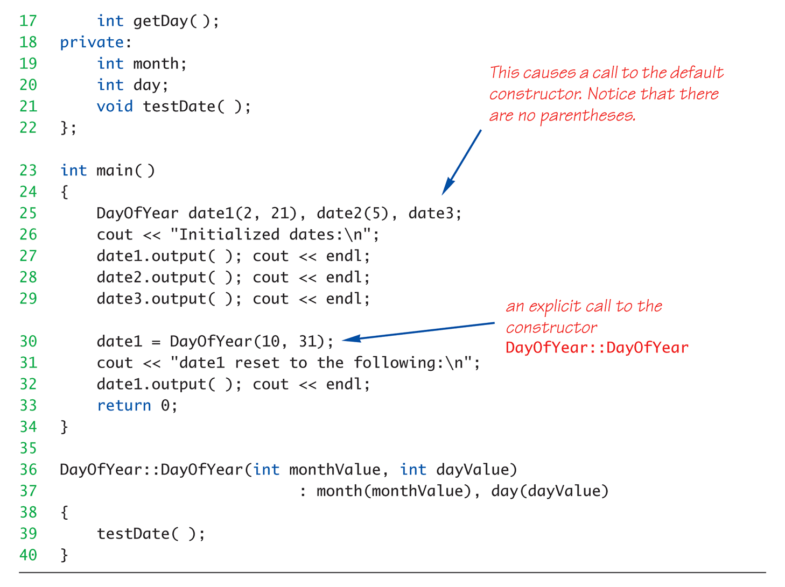
Class Constructors Overload Example (2 of 3)
Shorthand style used to initialize private members

Slide 42
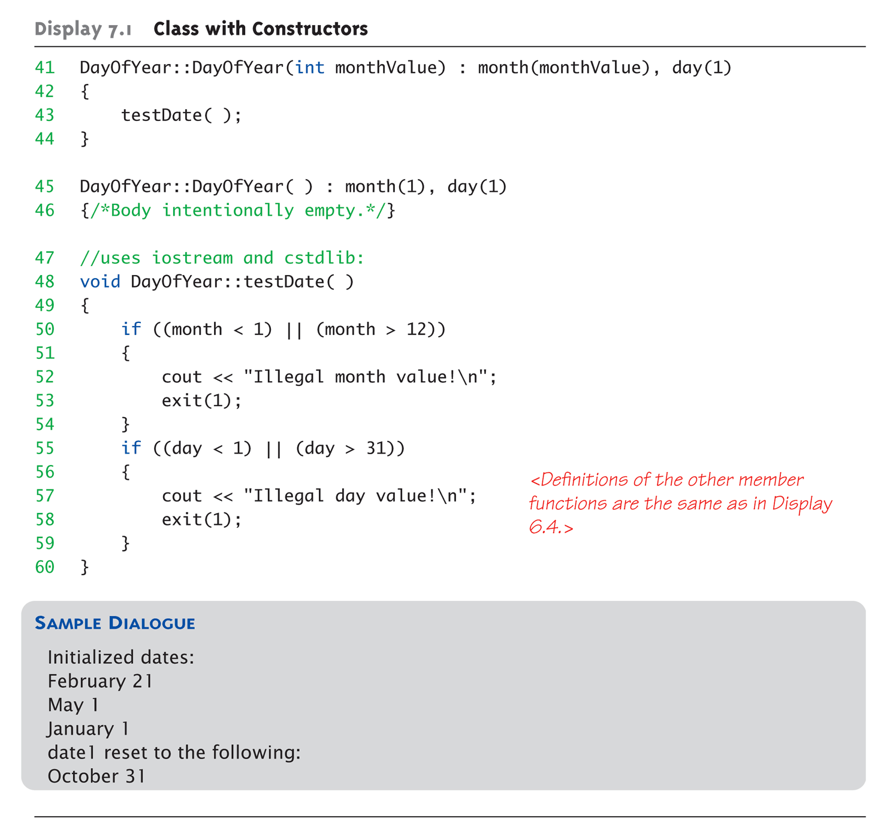
Class Constructors Overload Example (3 of 3)

Slide 43
Constructor with No Arguments
Default constructor
If no default constructor:
Cannot declare: MyClass myObject;
Can be confusing
Standard functions with no arguments:
Called with syntax: callMyFunction();
Including empty parentheses
Object declarations with no "initializers":
DayOfYear date1; // This way!
DayOfYear date(); // NO!
This is really a function declaration / prototype
Notes:
Auto-Generated?
Yes & No
If no constructors AT ALL are defined → Yes
If any constructors are defined → No

Slide 44
Explicit Constructor Calls
Can also call constructor AGAIN
After object declared
Recall: constructor was automatically called then
Can call via object’s name; standard member function call
Convenient method to reset member variables
Example
dayOfYear holiday(7,4);
Holiday = dayOfYear(5,5);
Initial declaration (of Independence)
Reset value to Cinco de Mayo!
Notes:
Explicit constructor call
Returns new "anonymous object"
Assigned back to current object

Slide 45
Default Constructor Practice
Open up the classes practice project
Add a new constructor function without arguments to the car class
Set the member properties
Make = “Ford”
Model = “F150”
VIN = “0000000”
MPG = 19.5
Declare car3 variable and print.

Slide 46
Nested Classes
Class member variables can be any type
Including objects of other classes!
Defines a relationship between classes
Need special notation for constructors
So they can call "back" to member object’s constructor

Slide 47
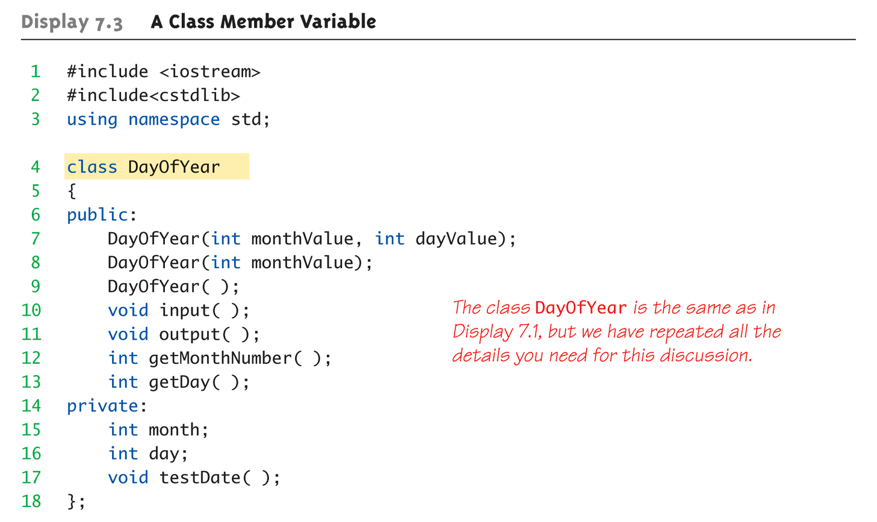
Nested Class Member Example: 1 of 5

Slide 48
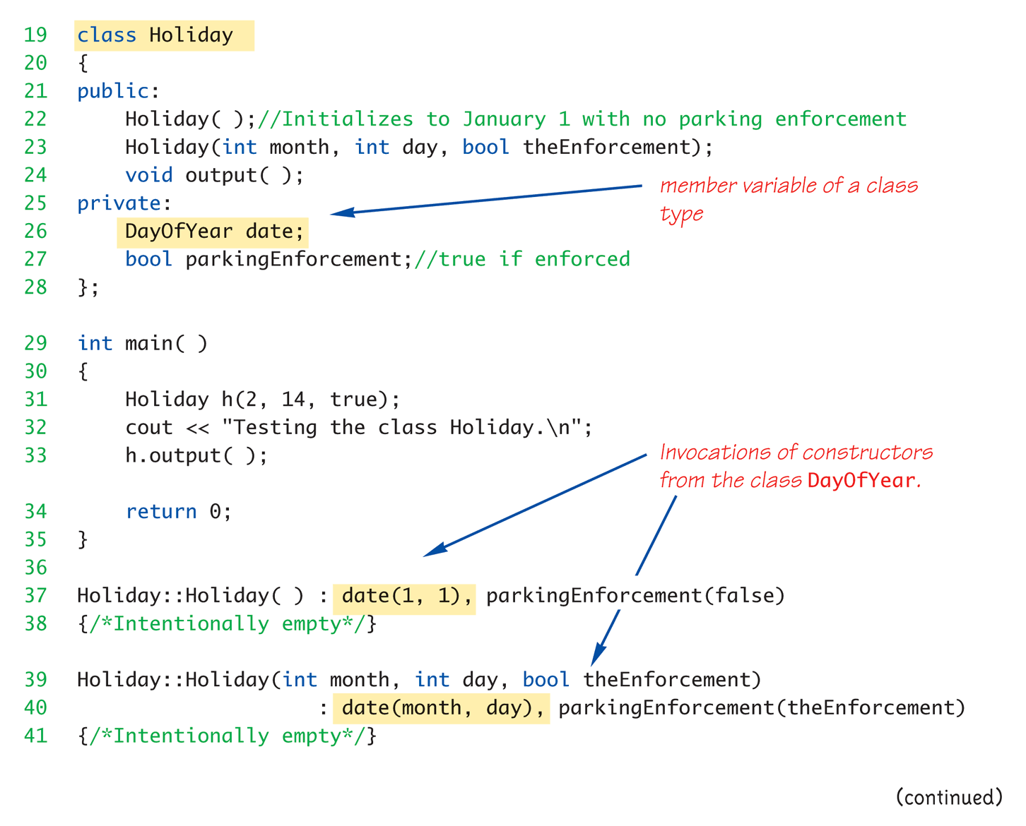
Nested Class Member Example: 2 of 5
New class defined with DayOfYear as nested member

Slide 49
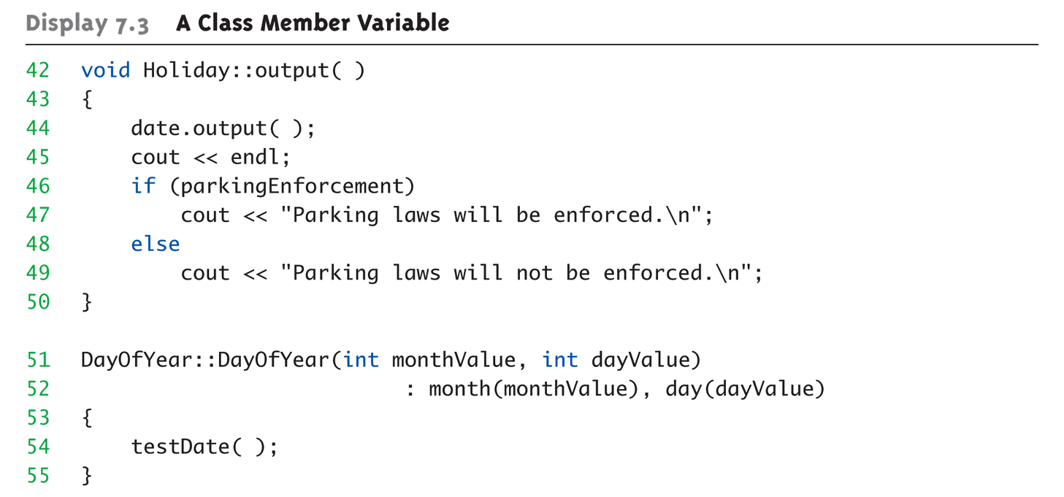
Nested Class Member Example: 3 of 5

Slide 50
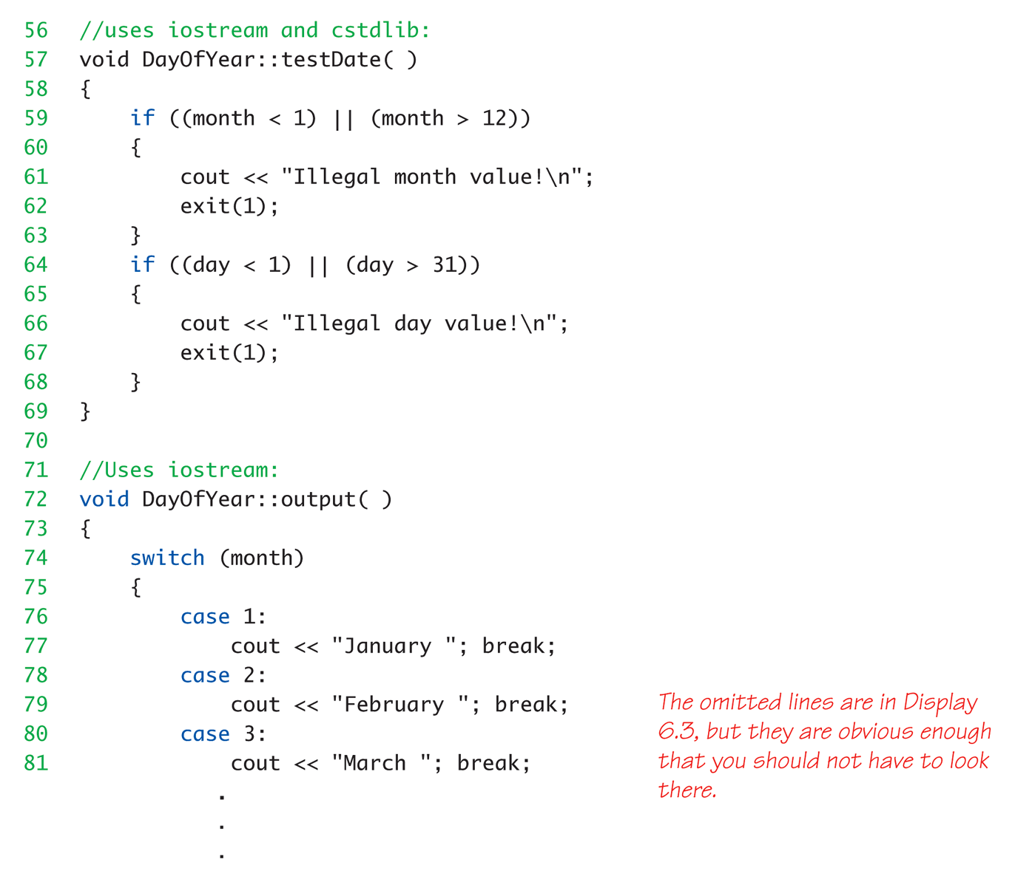
Nested Class Member Example: 4 of 5

Slide 51
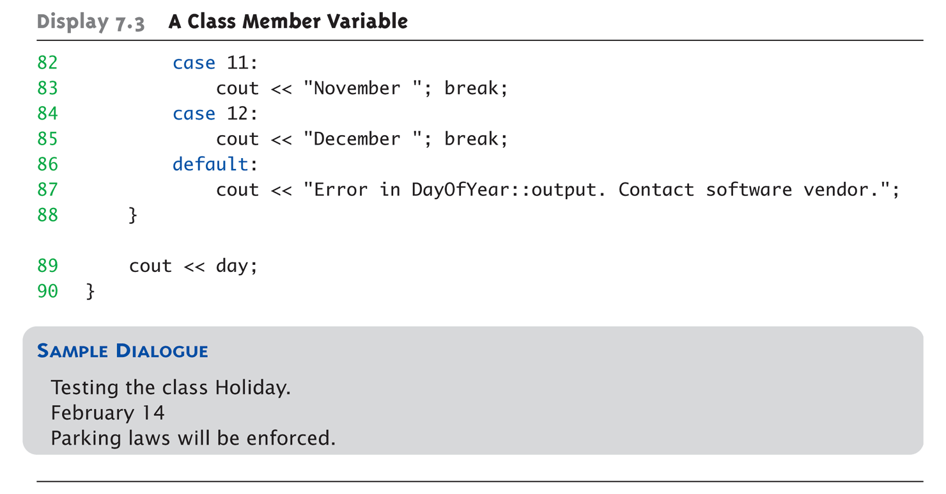
Nested Class Member Example: 5 of 5

Slide 52
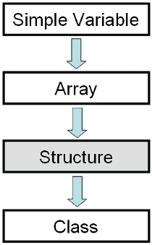
Structures versus Classes
Structures
Typically all members public
No member functions
Classes
Typically all data members private
Interface member functions public
Technically, same
Perceptionally, very different mechanisms

Slide 53
Back to Design - Object Pattern
An object pattern is a “best practice” for implementing
The state object patterns describes objects that
Maintain a body of data and provide suitable access to it by other objects and human users
Object patterns help us understand new objects
Many classes have these things in common
private data members store the state of objects
constructors initialize private data members
modifiers alter the private data members
accessors allow us to inspect the current state of an object or to have its state available in expressions.
Notes:
43
43

Slide 54
Key Takeaways
Class = Structure + functions
Also adds private and public parts
What’s the diff? _________________
Focus for programming changes
Before → algorithms center stage
OOP → data is focus
Algorithms still exist
They simply focus on their data
Are "made" to "fit" the data
Interface versus implementation

